Slide 1
Fraudulent Transaction Detector
Ashley Neville
Maxwell Miorada
Jay Cao
Chirath Abe

Slide 2
The Objective
-The purpose of this project is to highlight the importance of Machine learning in the financial sector, and to prove the usefulness of it with a model that has been developed to identify fraudulent credit card applications.
-We chose to build a model around identifying credit card fraud, as it is the most common in the sector, and has such a large negative impact on the system, costing banks and consumers 10’s of billions of dollars each year.

Slide 3
What is Fraud in Finance
Fraud is defined as obtaining a benefit, or causing a loss, by deception or other means.
Fraud in The financial sector is a Predominant problem in which causes billions of dollars worth of losses each year, using fraudulent or stolen information, perpetrators are able to do things such as :
-Gain access to credit cards of existing customers.
-Create new credit facilities with someone else’s information.
-Use stolen information for employment / tax related fraud.
-Use falsified information to claim government benefits.
Notes:
-Banks are the most prominent and important businesses in the Financial Sector
-CC Fraud costs banks and consumers billions of dollars yearly.

Slide 4
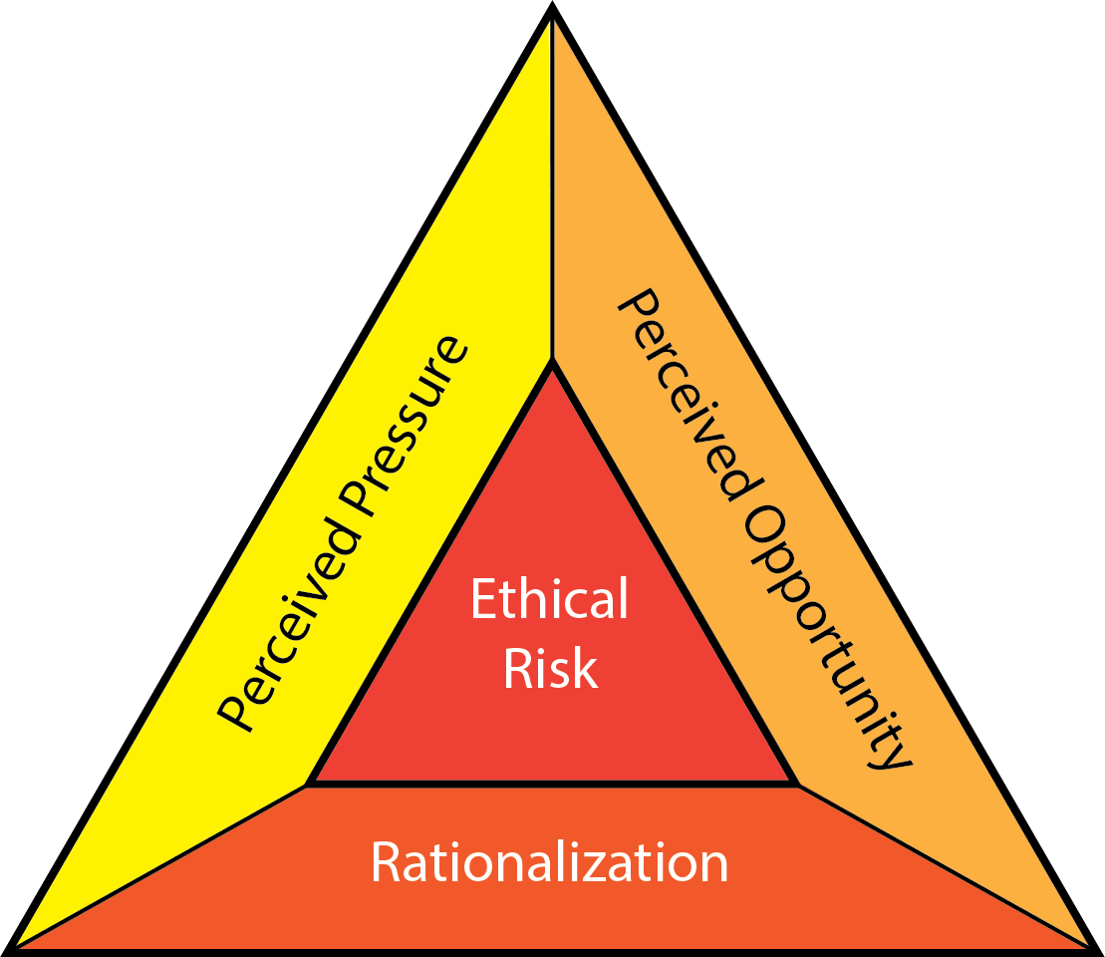
Why People Commit Fraud and The Drivers
Pressure; losing employment, addictions, health problems, crippling debts
Opportunity; often found in lack of oversight allowing for fraud to start small and increase once opportunity is confirmed
Rationalism; I deserve it, I pay enough tax, I’m doing it for my family etc..

Slide 5
Credit Fraud in Australia
Australian Card fraud rose by 0.6% to $467.6 million in 2020
Spending on Australian payment cards was $801.7 billion for 2020
Australians lost $851 million to scams in 2020, up 34% on 2019.

Slide 6
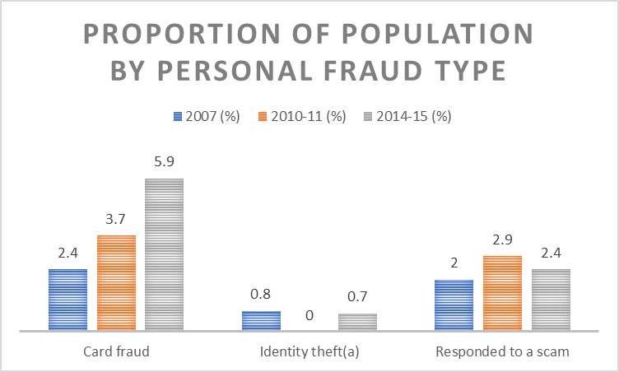
Credit Card fraud in Australia
The majority of persons who experienced personal fraud experience a single incident
The most common fraud type was card fraud with 5.9% of Australians aged 15 and over experiencing card fraud in 2014-15, an increased from 2010-11 when the rate was 3.7%
(Personal Fraud, ABS, 20/04/2016)

Slide 7
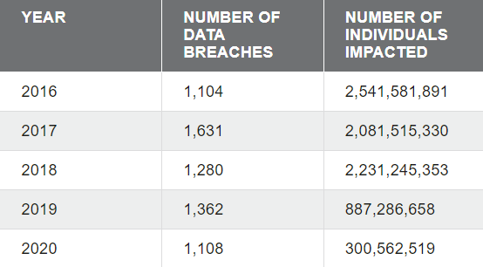
Data Breaches and CC fraud.
-Less Data Breaches.
-Less individuals impacted.
- new customer fraud = most common
CC fraud reports:
-2018 : 157,743
-2019: 271,927
-2020: 393,207
Notes:
What you can interpret from this data is that Technology is advancing and personal information is much safer online, therefore less personal data is accessible by hackers.
Less data breaches should mean less Fraud reports, but that is not what the data indicates. As fraud reports have almost doubled in 2 years.
This indicates the importance of using machine learning algorithms for identifying fraud. Even with stronger security in place to stop data breaches, we are still seeing fraud reports go up at an alarming rate.

Slide 8
The Data Presented
- In a bid to solve the problem presented, we have developed a ML model to detect CC fraud.
-Dataset has more than 20 million transactions from a multi agent virtual world simulation performed by IBM
-Dataset consists of 2000 synthetic consumers in the United States, who travel the world.
-Synthetic data allows for us to see consumer information for analysis, so there is no obfuscation.
-Synthetic data works for the same purpose in making a model
-Non synthetic data would show no consumer data as it is confidential.

Slide 9
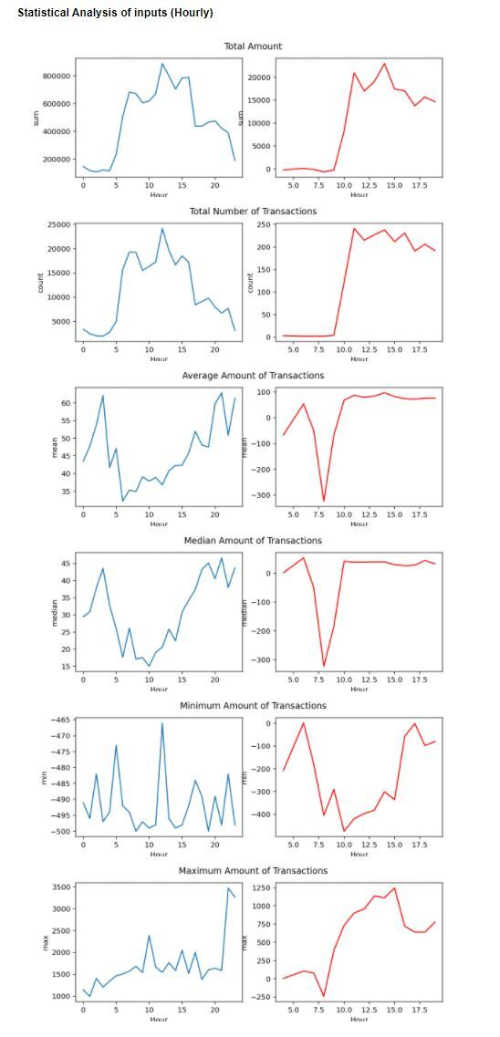
Statistical Analysis of Inputs (Hourly)

Slide 10
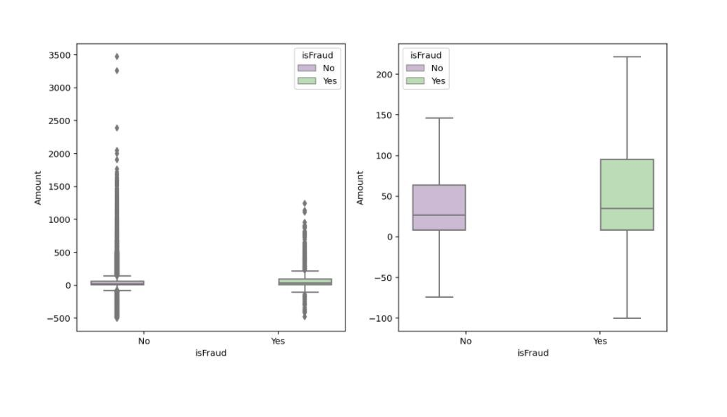
Box Plot of Data Set

Slide 11
More interesting stats about the data
All 2087 fraudulent transactions didnt’ have their card details exposed on the dark web
Average 8 years since they last changed their passwords
50.8% of the fraudulent transactions are debit cards, with prepaid cards making up only 7.8%.
90.8% of the credit cards with fraudulent transactions contains chips
Average age of victims are 56.16years old
FICO scores of the victims are 716 (Max at 850)
52.7% of the victims are male
Top 5 states where victims reside are Texas, New York, California, Florida, Illinois, Pennsylvania.

Slide 12
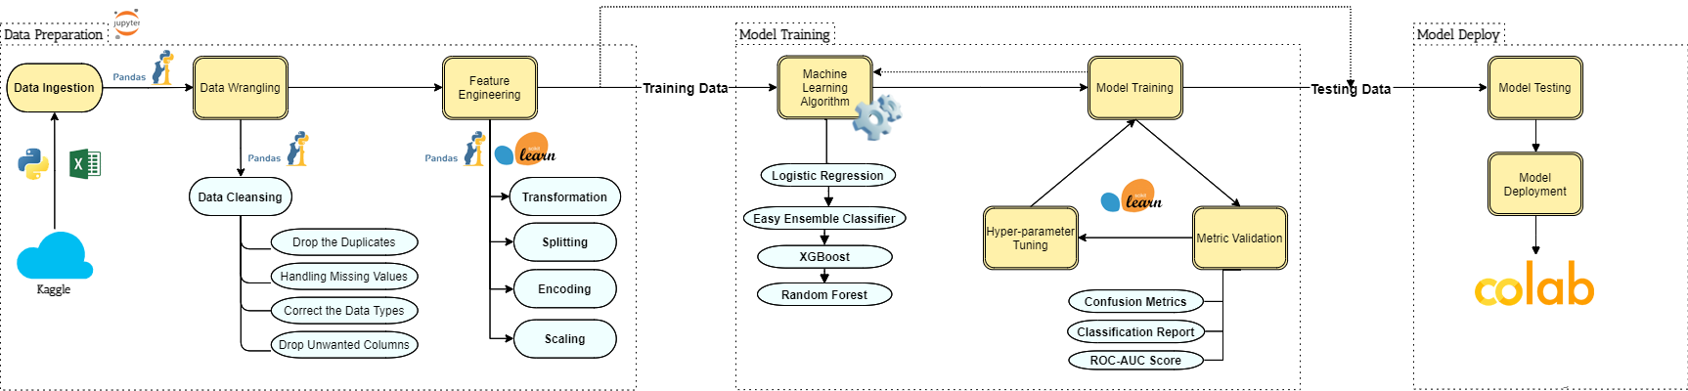
Machine Learning Pipeline

Slide 13

Model Comparisons based on Test Data

Slide 14
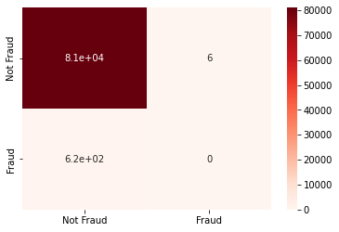
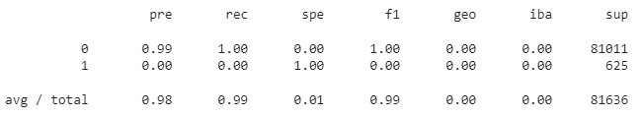
Logistic Regression
ROC AUC Score: 0.4999

Slide 15
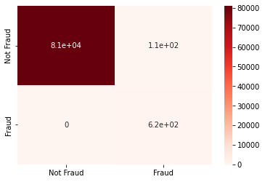
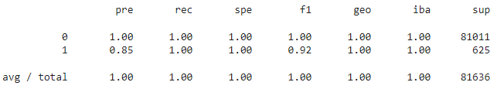
Easy Ensemble Classifier
ROC AUC Score: 0.9993

Slide 16

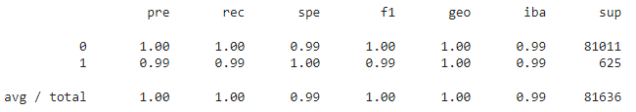
XGBoost Classifier
ROC AUC Score: 0.9951

Slide 17

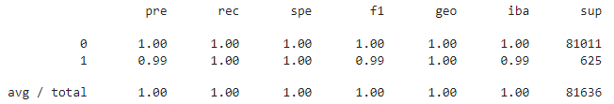
Random Forest
ROC AUC Score: 0.9975

Slide 18
Challenges
One of the challenges we faced came with our data, having 24 million rows we had to reduce to a workable size without creating a bias.
Lengthy training time
Poor quality of data, possibility of measuring error (have to trust data after cleaning process)
Overfitting and underfitting
Curse of Dimensionality

Slide 19
Q&A
?
?
?

